Slide 1

Week 3
AI Lecture Series

Slide 2
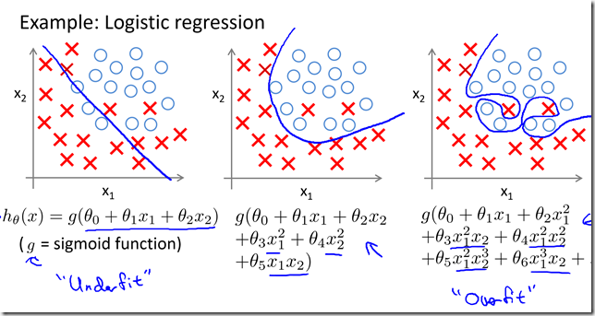
CLASSIFICATION
Logistic Regression

Slide 3
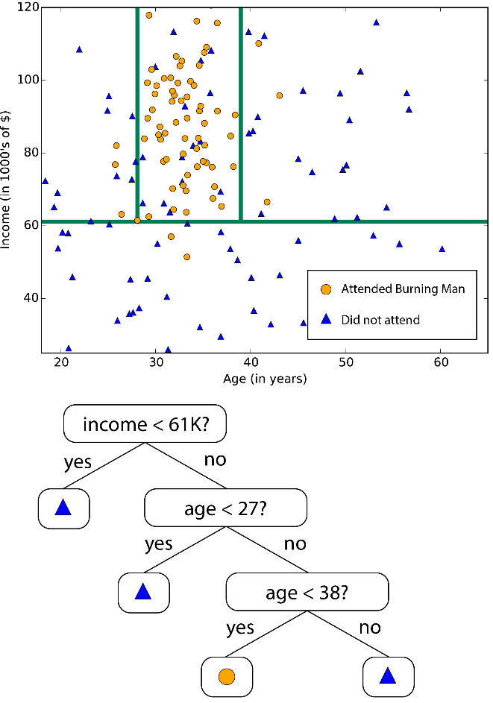
CLASSIFICATION
Decision Trees

Slide 4
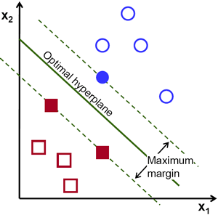
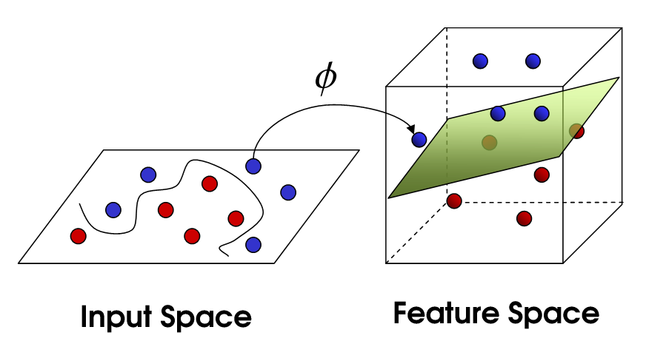
CLASSIFICATION
Support Vector Machines

Slide 5
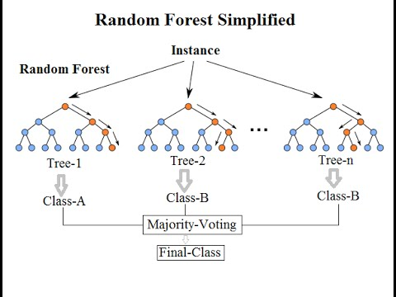
CLASSIFICATION
Random Forests

Slide 6
CLASSIFICATION
Random Forests

Slide 7
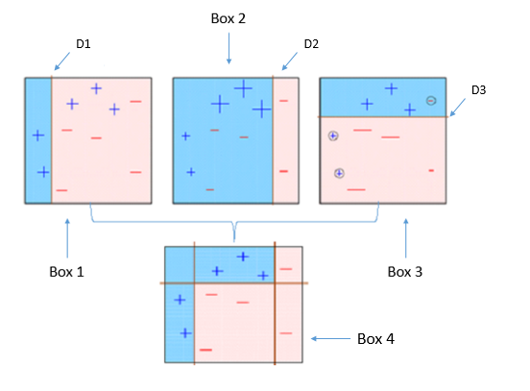
CLASSIFICATION
Boosting

Slide 8
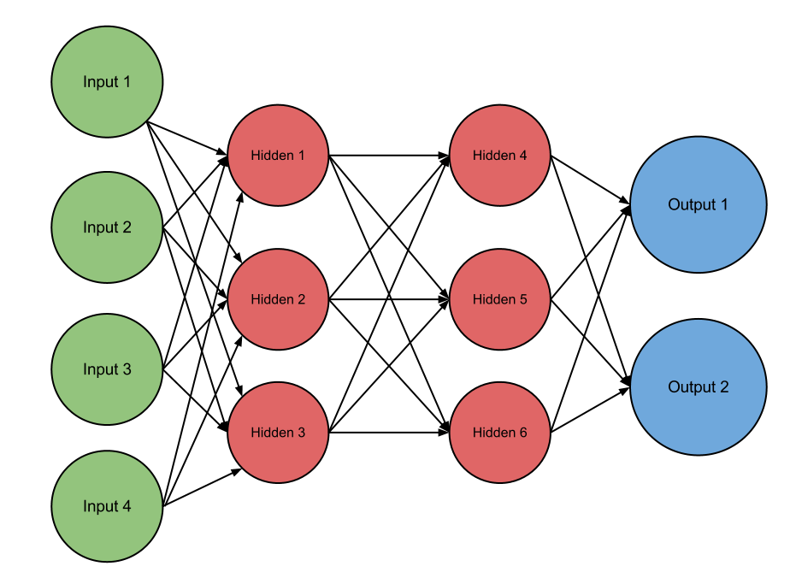
CLASSIFICATION
Neural Networks

Slide 9
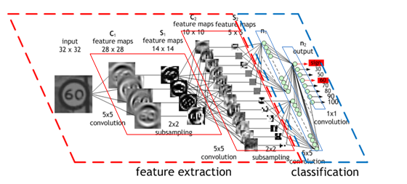
CLASSIFICATION
Convolutional Neural Networks

Slide 10
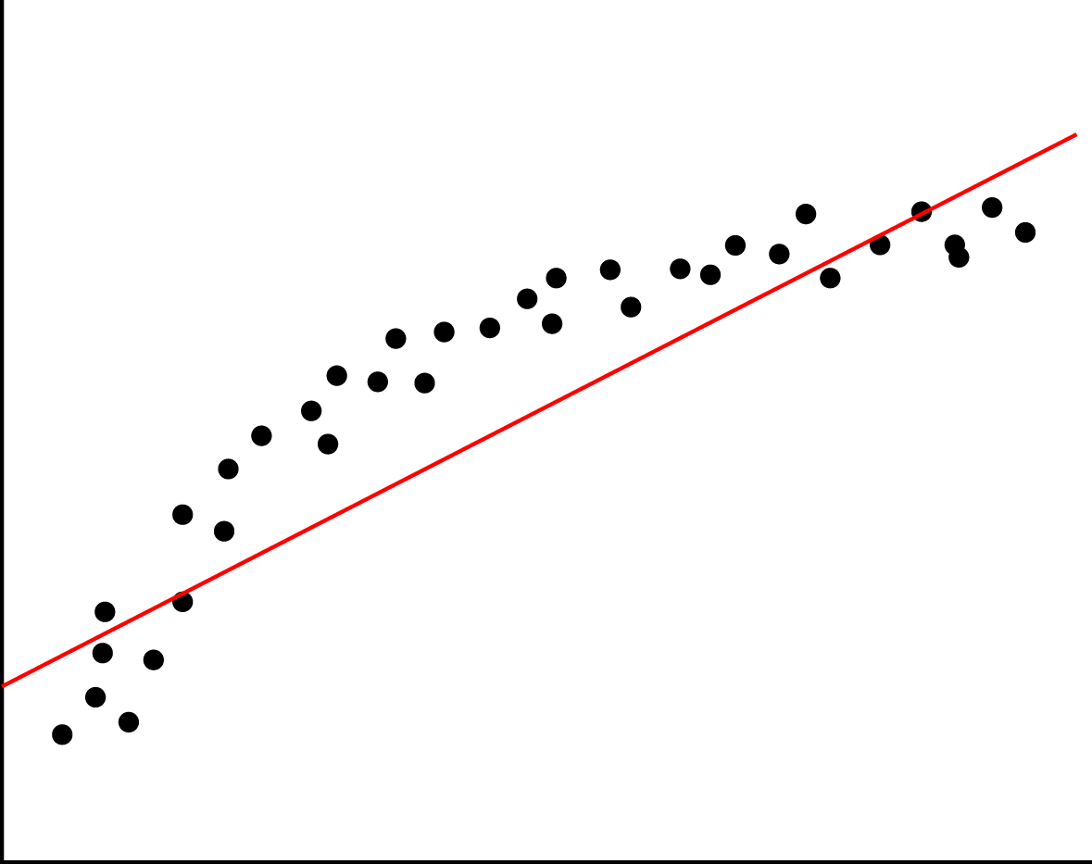
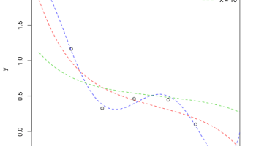
REGRESSION
Linear Regression

Slide 11
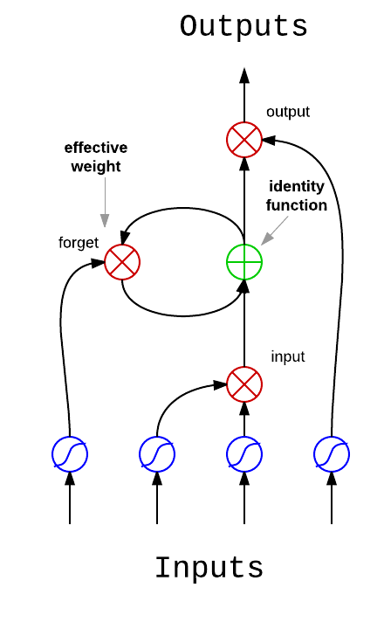
REGRESSION
Recurrent Neural Networks

Slide 12
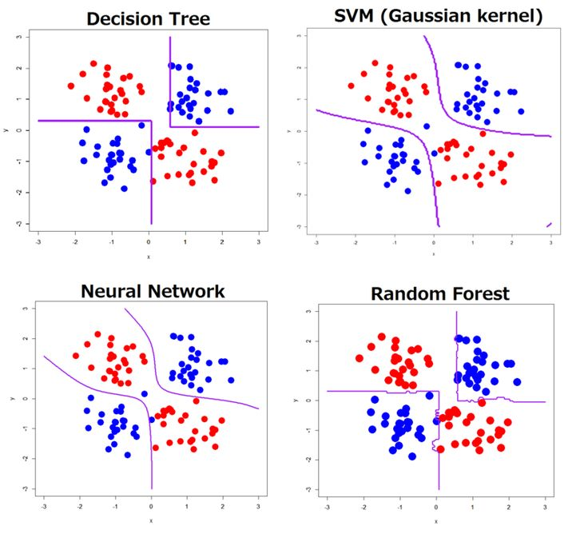
CLASSIFICATION differences

